Slide 1
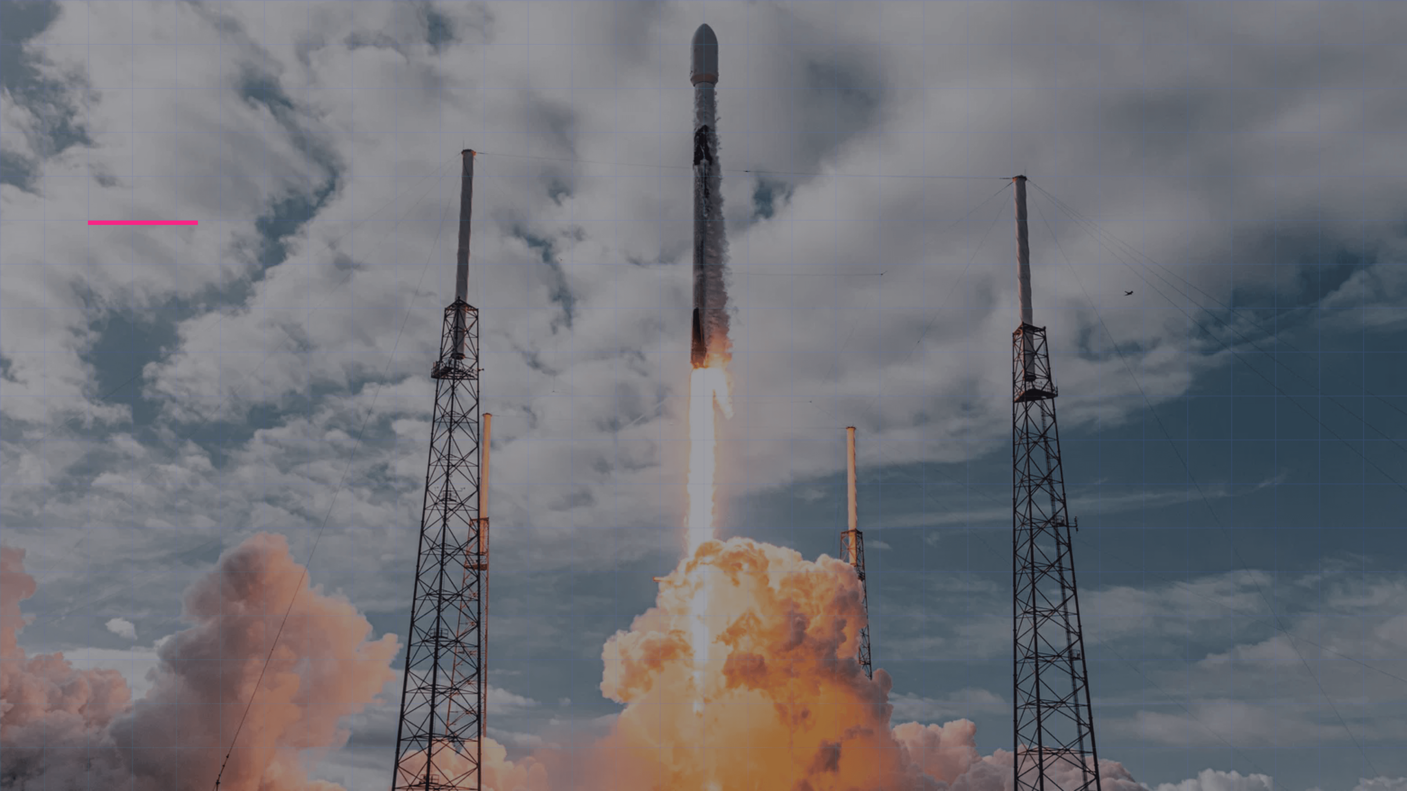
Winning the Space Race
Predicting Falcon 9 First Stage Landings
ROLE
Lead Data Scientist, SpaceY
PROJECT
Applied Data Science Capstone

Slide 2

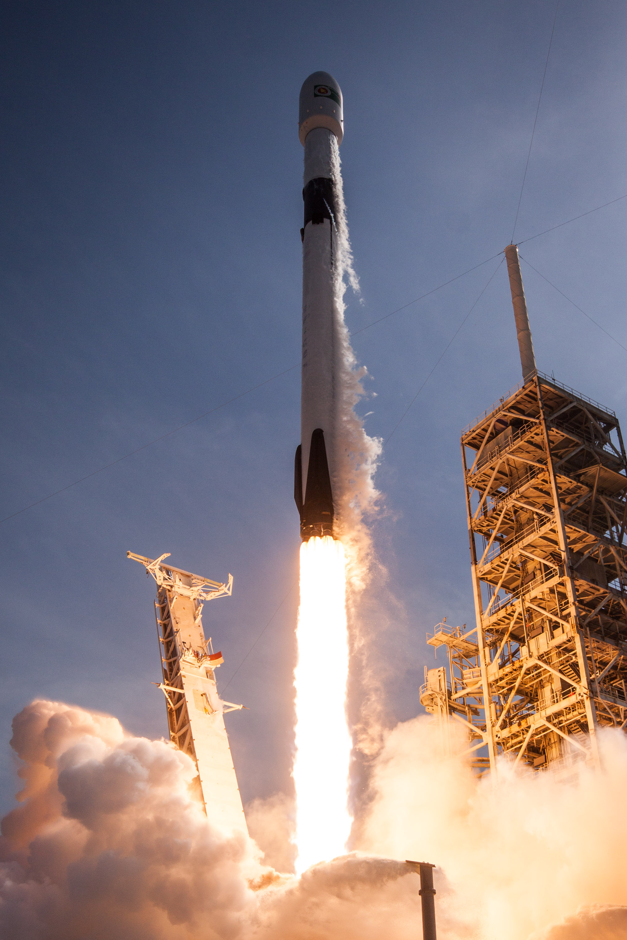
Executive Summary
Data-Driven Proof of Reusability Feasibility
Main Objective
Determine the feasibility of reusing the Falcon 9 first stage to reduce SpaceY's launch costs and compete effectively with SpaceX.
Key Findings
Analysis confirms reusability is technically viable and predictable. Landing success is highly correlated with specific orbits and launch sites.
90%
83.3%
Recent Success Rate
Model Accuracy
Business Impact
The predictive model enables accurate cost estimation and identification of low-risk mission profiles, potentially saving millions per launch.

Slide 3

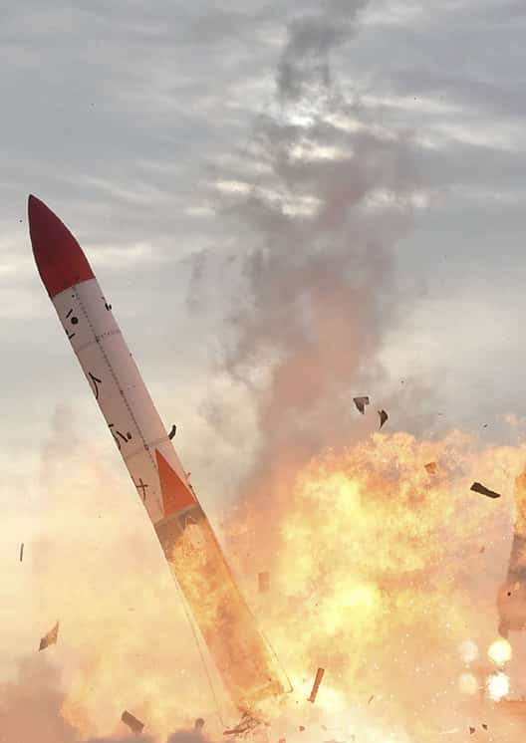
Introduction & Context
The Competitive Challenge of the Space Industry
SpaceX Cost
Competitors
$62M
$165M+
per launch
per launch
Business Problem
Savings come from reusability. To compete, SpaceY must predict if the first stage will land successfully based on pre-launch data.
01
02
03
04
Collect Data
Clean & Analyze
Model
Validate

Slide 4

Methodology
Data Collection & Wrangling Process
Data Sources
Data Wrangling
SpaceX REST API
Filtering & Cleaning
Automated extraction of technical launch details: flight number, date, booster version, payload mass, orbit, and launch site.
Exclusive focus on Falcon 9 launches. Missing value treatment in PayloadMass by replacing with the mean (~6,123 kg).
Web Scraping
Target Variable (Class)
Historical data collection from Wikipedia ("List of Falcon 9 launches") using BeautifulSoup to obtain past mission outcomes.
Creation of a binary variable for classification: 1 = Successful Landing 0 = Unsuccessful Landing (Crash, Ocean, None)

Slide 5

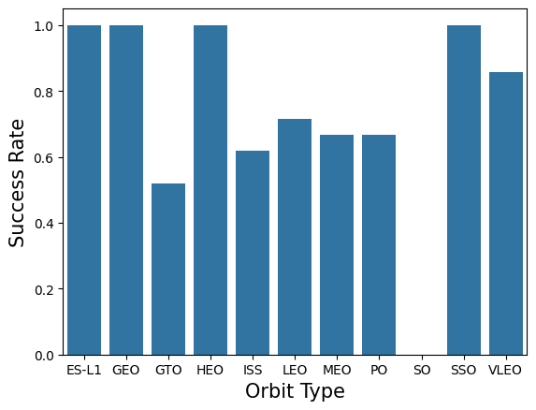
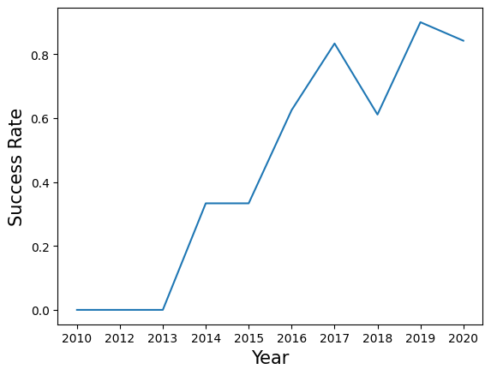
Methodology
EDA & Interactive Visual Analytics
Exploratory Data Analysis (EDA)
Extracting critical metrics and visualizing relationships between variables such as Flight Number, Orbit Type, and Payload Mass.
SQL
Pandas
Seaborn
Interactive Analytics
Geospatial mapping of launch sites and dynamic dashboards for real-time success rate filtering.
Folium Maps
Plotly Dash
"Identify visual patterns and hidden correlations that inform the construction of robust predictive models."

Slide 6

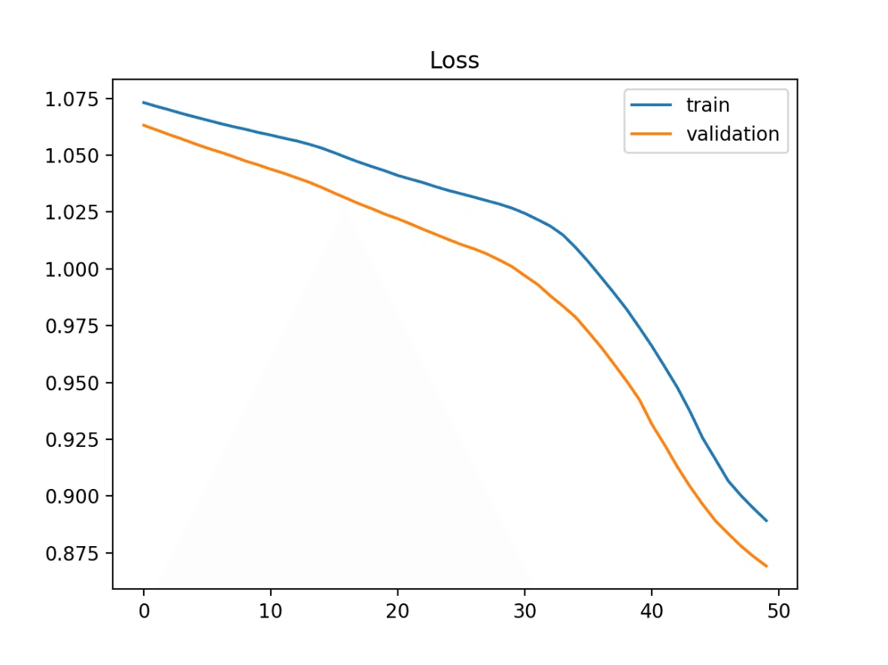
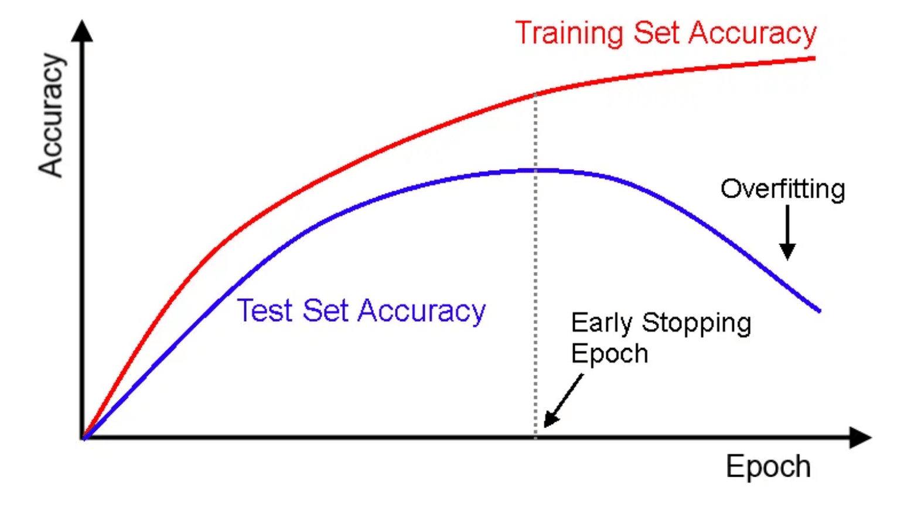
Methodology: Predictive Analysis
Machine Learning Models and Optimization
Data Preprocessing
Standardization:
Used
StandardScaler
to normalize features.
Data Splitting:
80% Training | 20% Testing for robust validation.
Models Tested
Logistic Regression
SVM
Baseline for binary classification.
RBF kernel for non-linear boundaries.
Learning Curves Analysis
Decision Tree
KNN
Interpretable rule-based model.
Proximity-based classification.
Optimization & Evaluation
GridSearchCV:
Exhaustive hyperparameter tuning.
Cross-Validation:
10-fold CV implementation.
Metrics:
Accuracy, Confusion Matrix, Precision, and Recall.
Performance Metrics Deep Dive

Slide 7
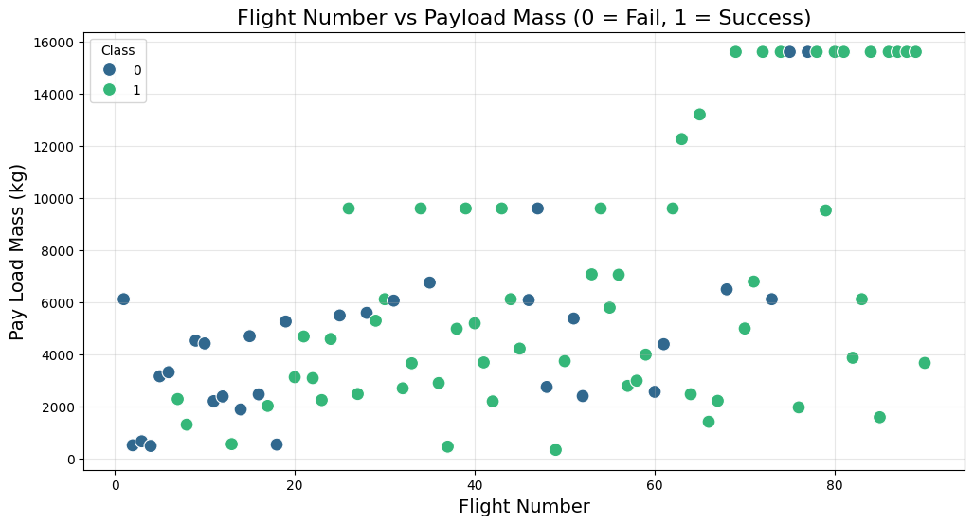
EDA Results
Visual Insights & Patterns
Payload vs. Launch Site
Heavy payloads (>8,000kg) are exclusively launched from KSC LC-39A and CCSFS SLC 40. VAFB SLC 4E handles lighter polar orbit missions.
Success Rate by Orbit
100% Success Rate observed for ES-L1, GEO, HEO, and SSO orbits. SO (Sun-Synchronous) orbits showed the lowest performance.
Yearly Trend
Consistent growth in success rates from 2013 to 2020, validating the technological maturity of the landing system over time.

Slide 8
EDA Results: SQL Insights
Key Statistics Extracted via SQL
45,596 kg
2,534 kg
98
Total NASA Payload
Average Payload
Successful Missions
CRS Missions
F9 v1.1
Recorded in Database
SLC 40
15,600 kg
Top Launch Site
Max Payload Booster
CCSFS (Most Frequent)
F9 B5 Series (e.g., B1048)
Strategic Insight
High-activity sites like CCSFS SLC 40 and KSC LC-39A demonstrate robust infrastructure and a proven track record, making them priority candidates for SpaceY development.

Slide 9
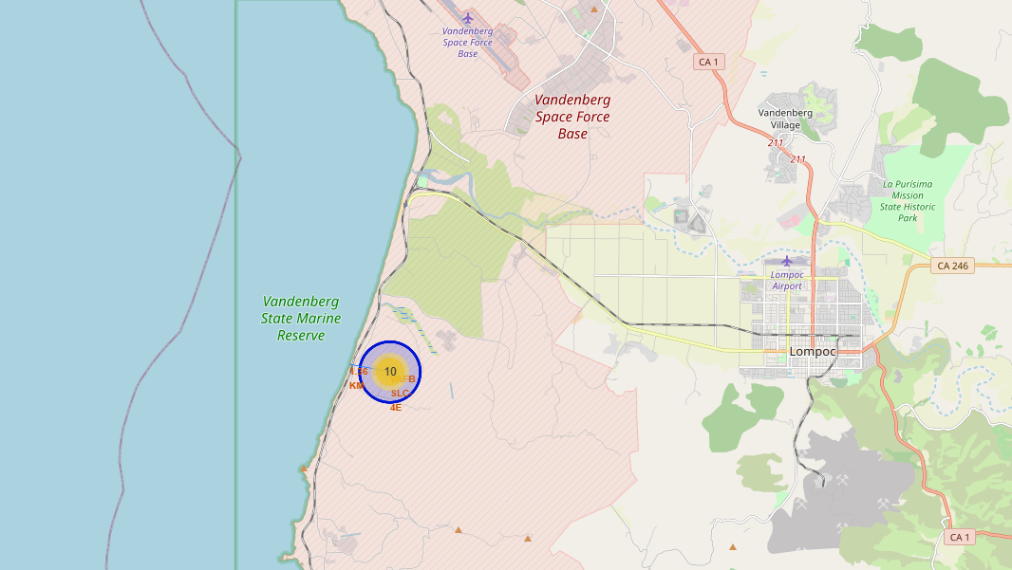
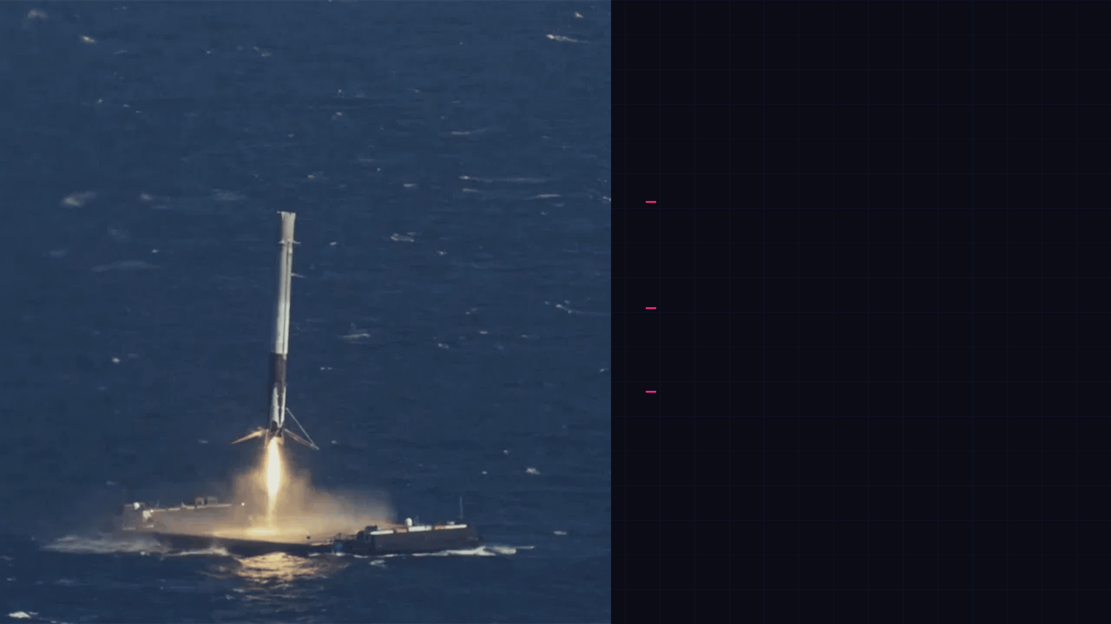
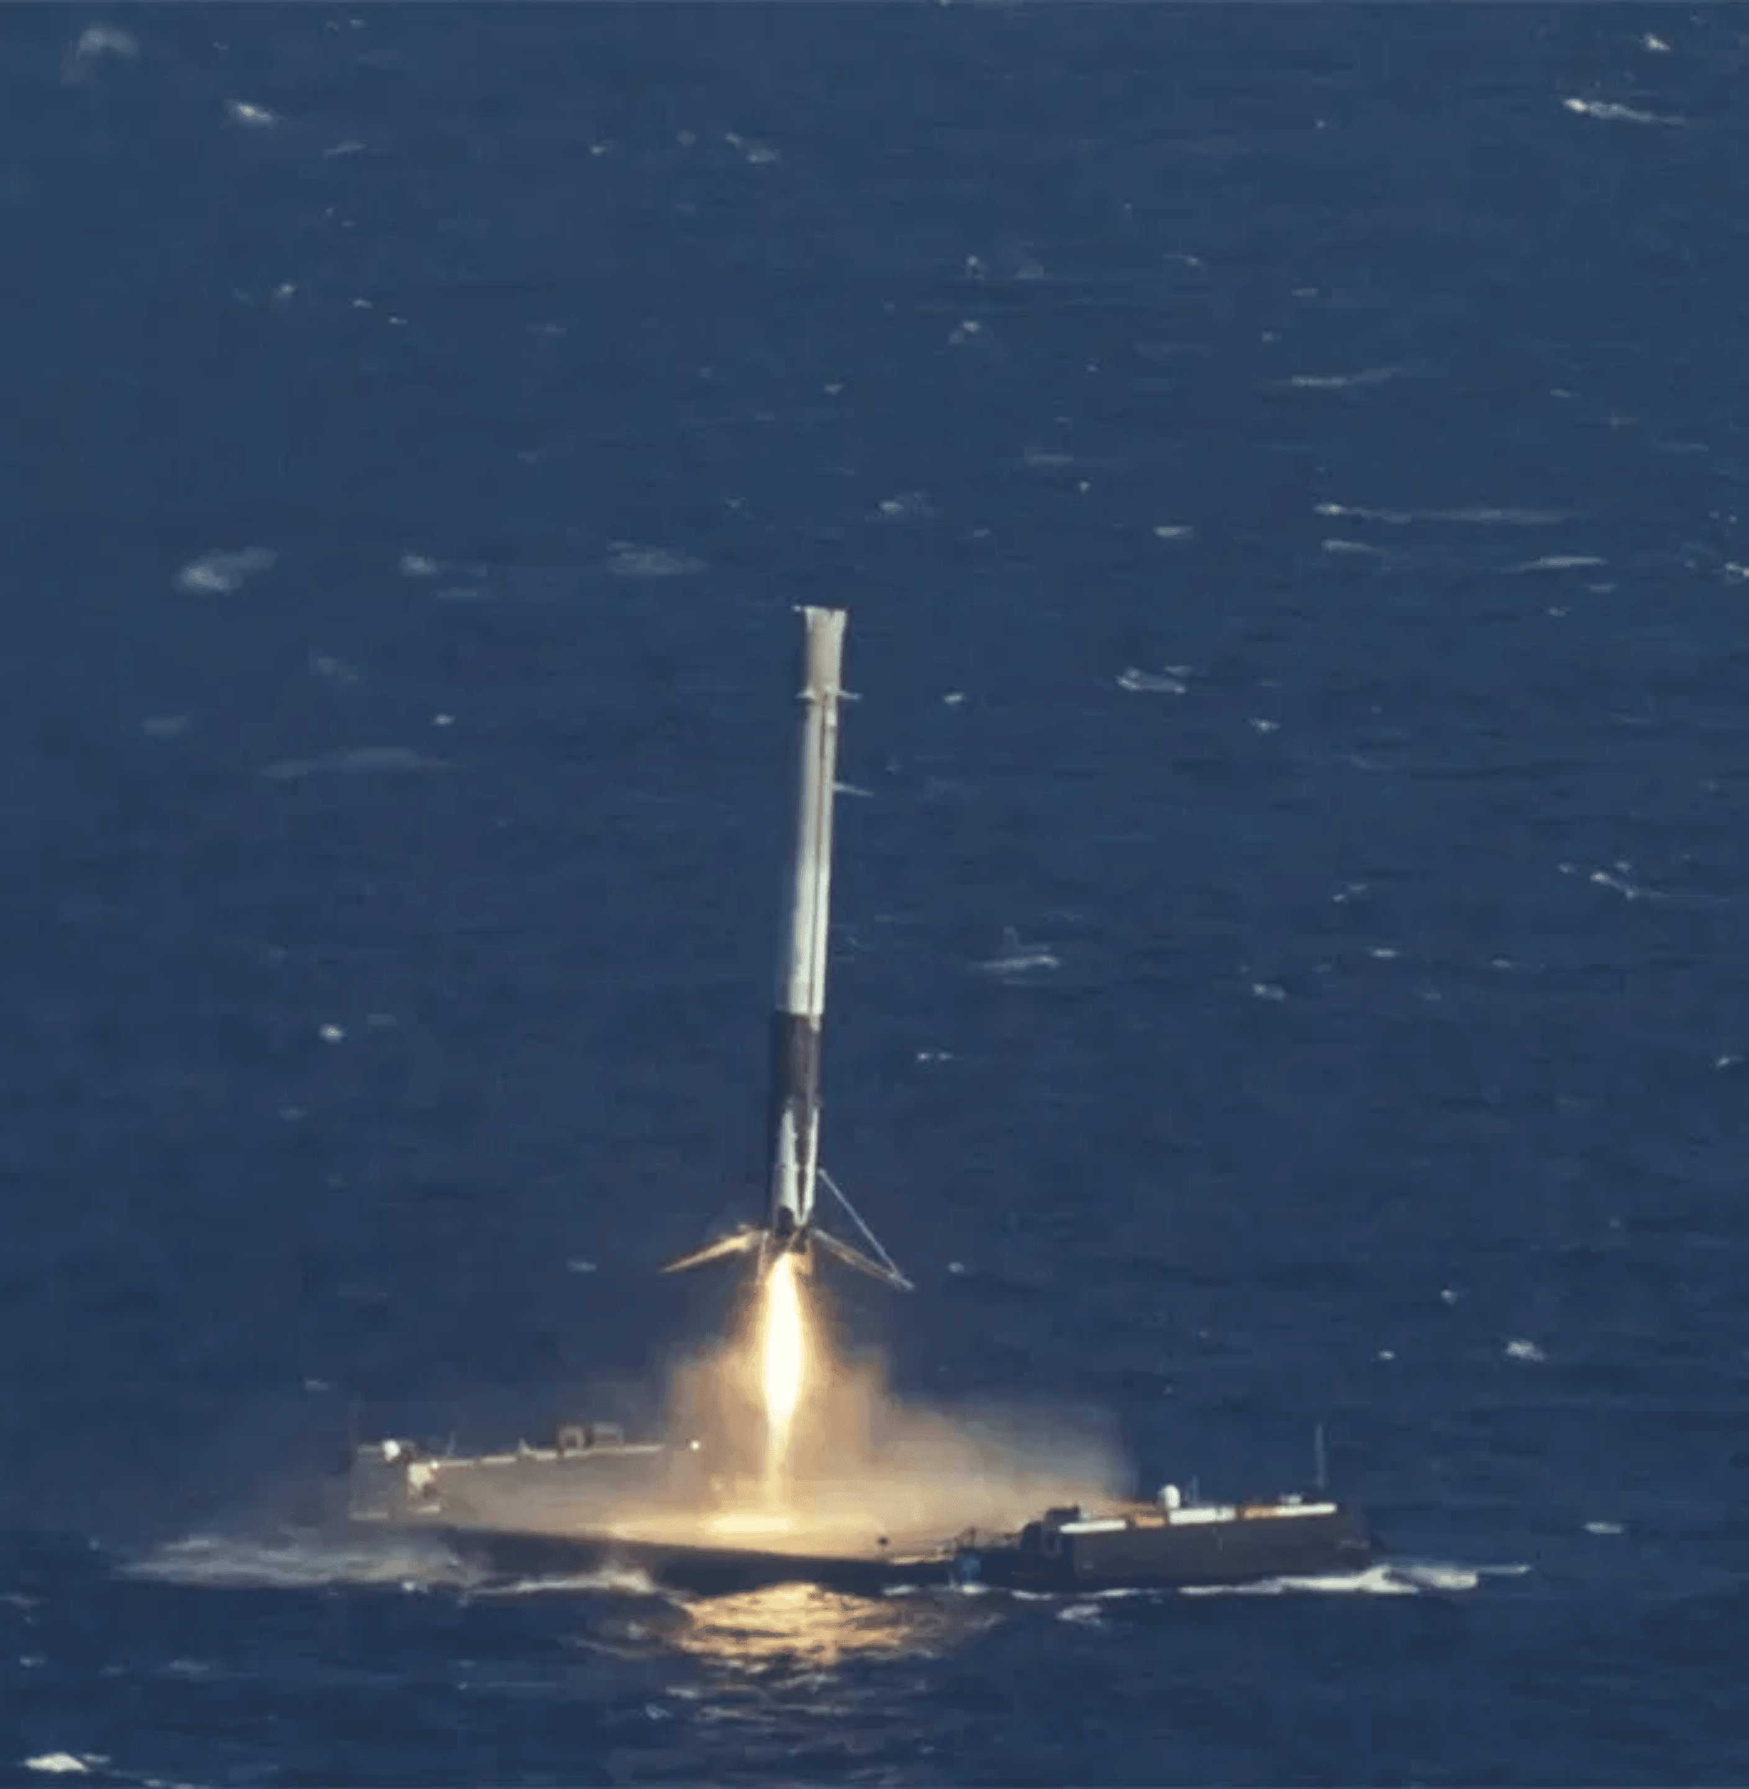
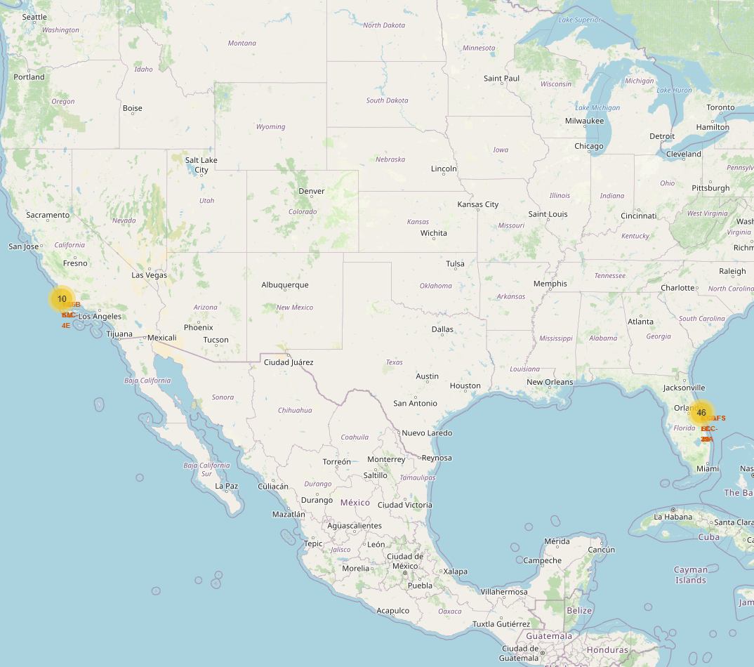
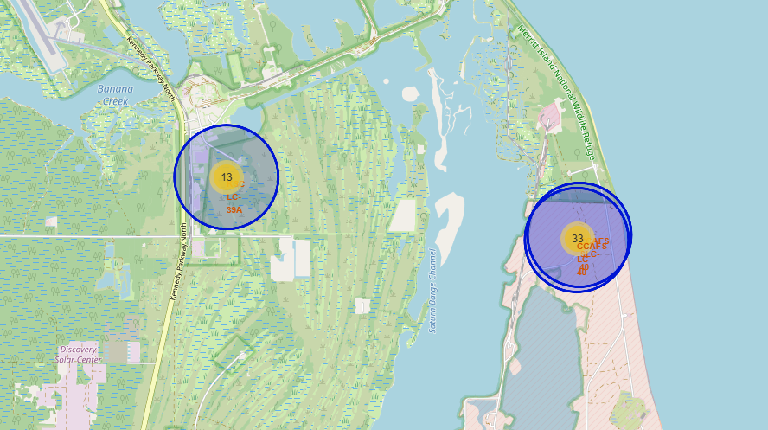
Results
Geospatial Analysis & Safety
Coastal Proximity
All launch sites are strategically located near the coastline to
facilitate oceanic recovery.
VAFB SLC-4E: ~1.36 KM from coast
Flight Corridors
Launches are directed over the ocean to minimize risk to populated areas, cities, and railways.
Success Clusters
Cluster visualization confirms that successful landings vastly outnumber failures in designated zones.
Recommendation
"SpaceY should prioritize the development of coastal facilities to maximize safety and align with proven industry success standards."

Slide 10

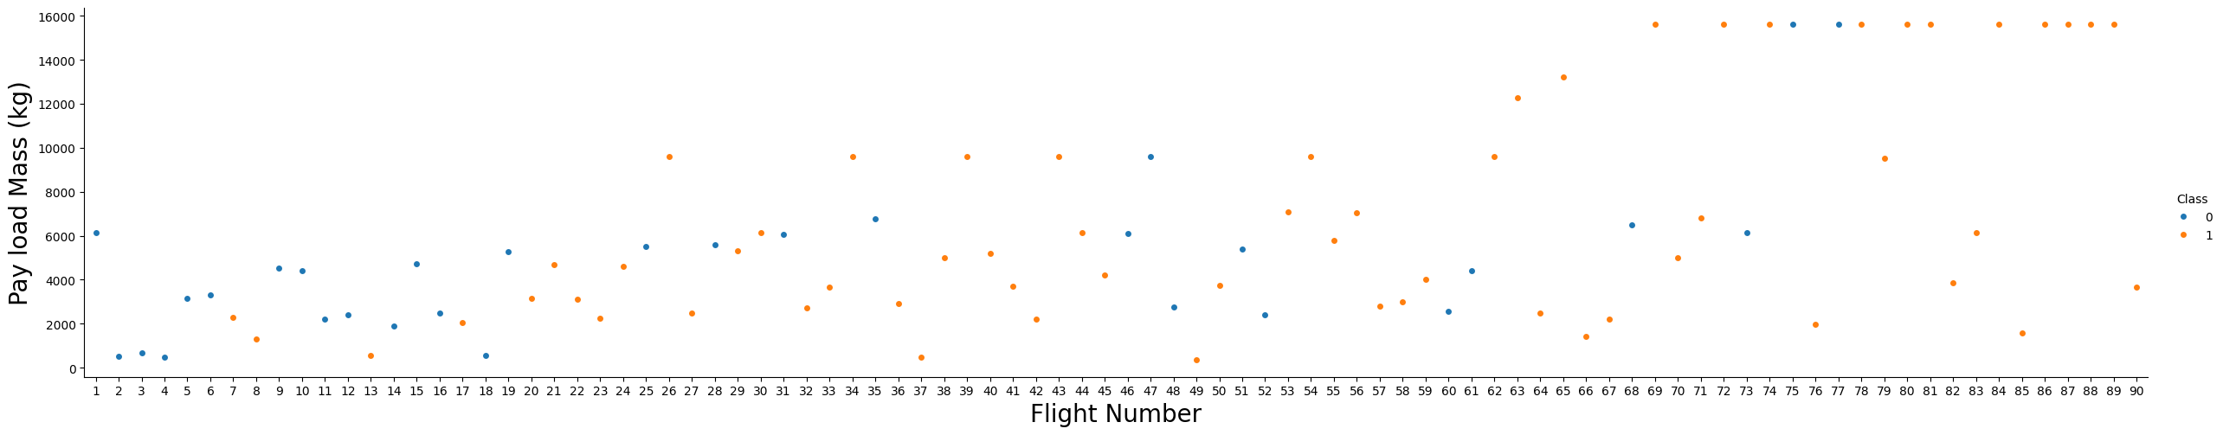
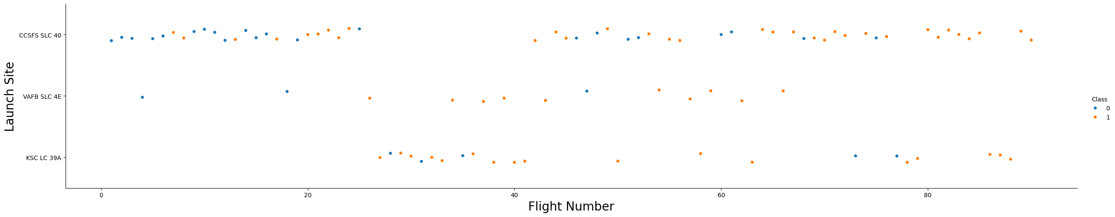
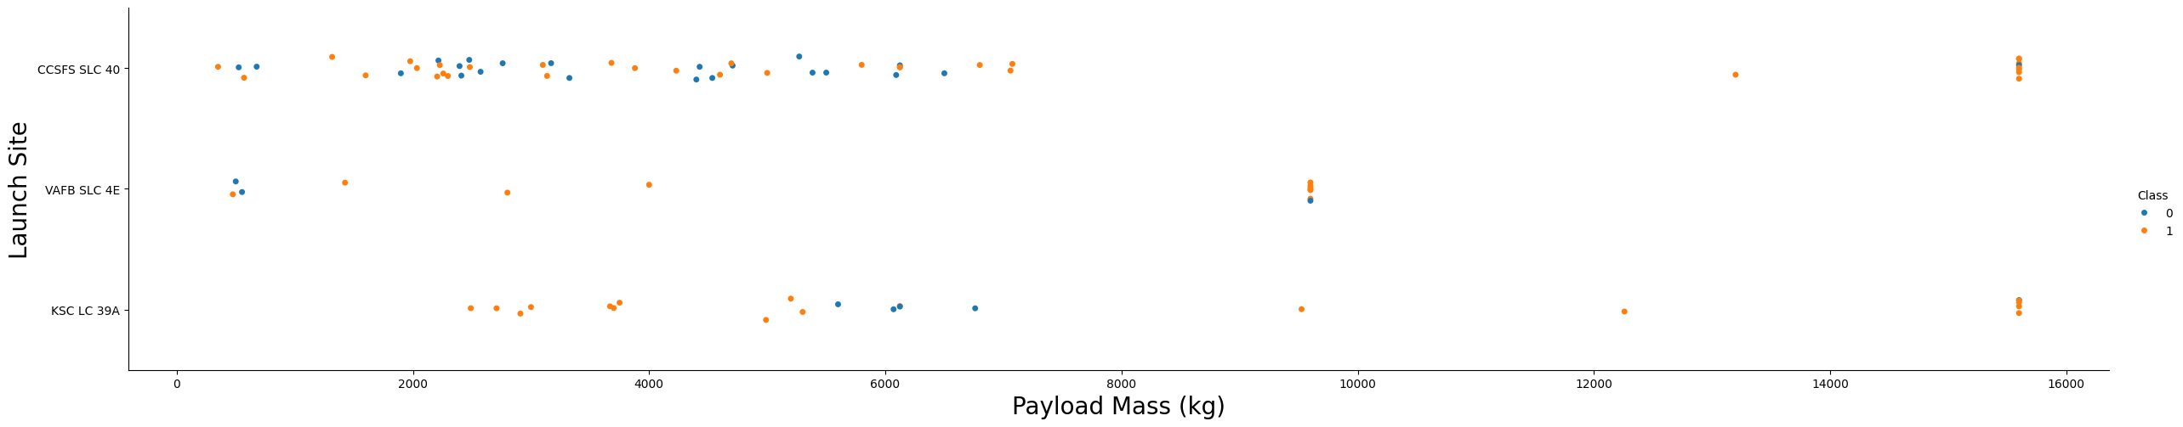
Results: Plotly Dashboard
Dynamic Insights on Payload and Performance
Dashboard Capabilities
▹
Dynamic filtering by
Launch Site
▹
Input slider to filter by
Payload Mass (kg)
▹
Interactive real-time visualization of success rates
Main Insight
Mid-range payloads (2,000kg - 6,000kg) show the highest consistency of landing success across all sites.
Practical Application
Quick mission feasibility assessment based on payload specifications and launch site.

Slide 11
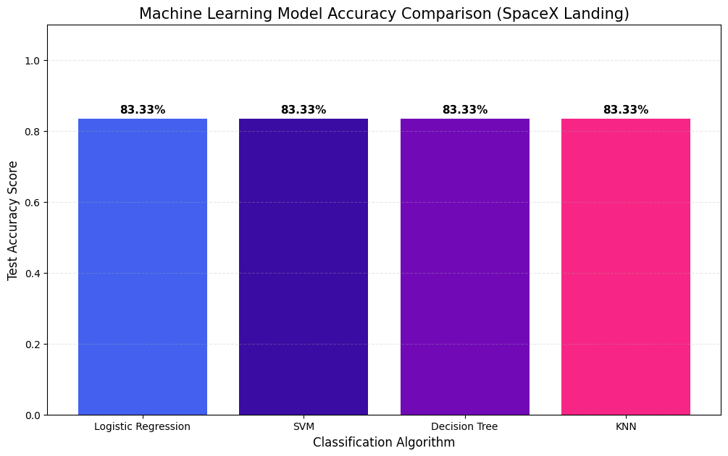
Results
Machine Learning Model Performance
Logistic Regression
83.33%
Support Vector Machines (SVM)
83.33%
K-Nearest Neighbors (KNN)
83.33%
Decision Tree
72.22%
Confusion Matrix Analysis
Models predict "Success" (1) with high precision. The primary source of error is False Positives influenced by class imbalance.
Recommendation
We recommend using Logistic Regression or SVM for their consistency and lower risk of overfitting.

Slide 12
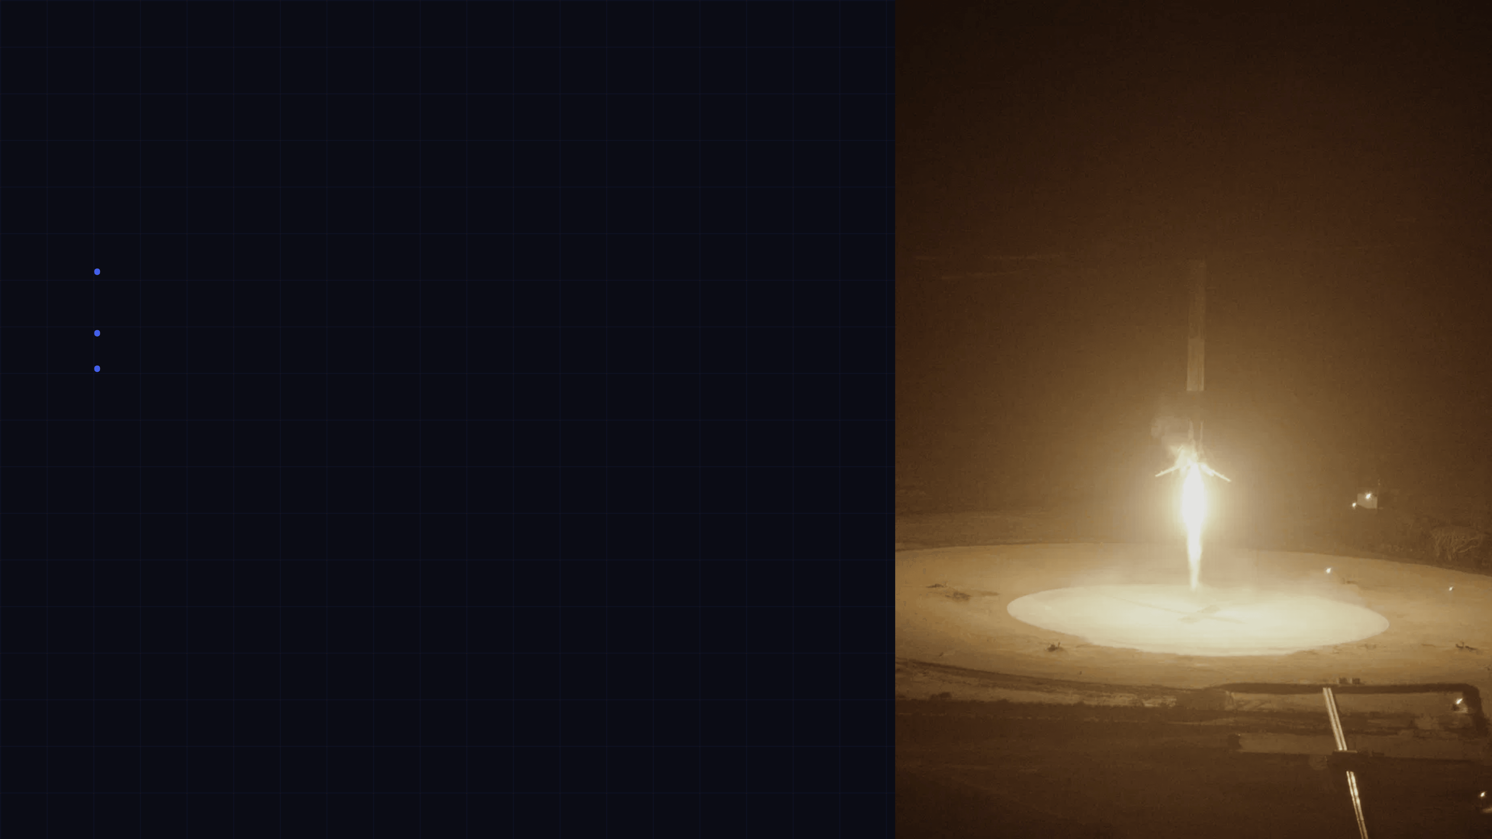
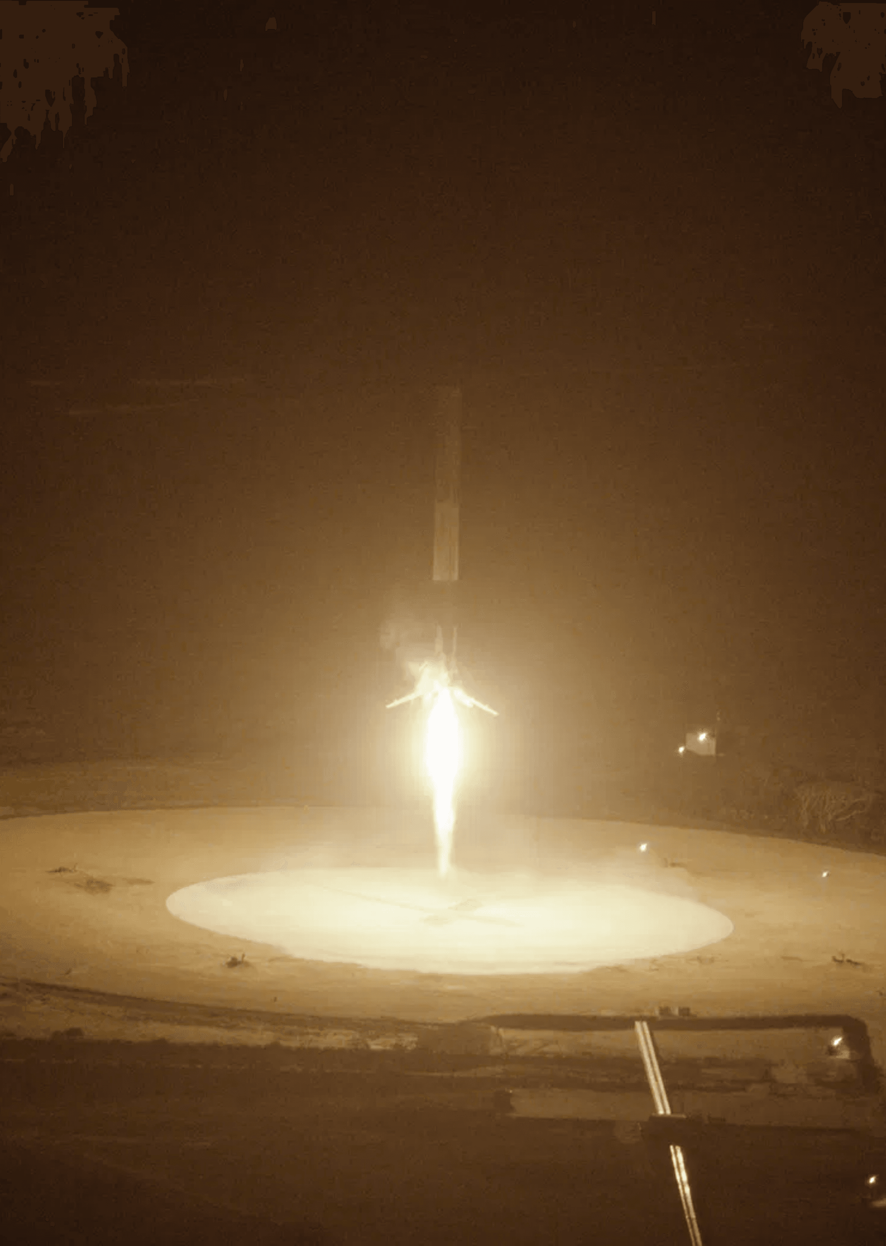
Conclusion
Strategic Path for SpaceY
Key Conclusions
•
Landing success can be predicted with
using classification models (LR, SVM, KNN).
~83% accuracy
•
Orbit Type
and
Payload Mass
are the most critical determinants of success.
•
Coastal launch infrastructure is the proven industry standard for safety and recovery.
Strategic Recommendations
1. Infrastructure
2. Market Focus
Prioritize coastal launch facilities similar to KSC LC-39A.
Initially concentrate on LEO and GTO missions (high success rates).
3. Risk Management
4. Optimization
Use predictive models to assess risk before reuse contracts.
Focus on mid-range payloads (2k-6k kg) for maximum consistency.
Next Steps: Refine model with real-time data and integrate into the operational decision pipeline.

